Slide 1
Group 4: Mid-way Project Presentation:
Loan Prediction using Machine Learning

Slide 2
Overview
Data-frame
Data analysis
Algorithms
Comparison
Post-Midway plans
References

Slide 3




New applicant
Old applicant

Slide 4
Data-frame
Household data and Individual data were obtained from NSS(National Sample Survey) 77th round, All India debt & investment survey 2019.
Very huge dataset with 3,19,343 observations and 36 features
Different data frame (from the earlier mention during proposal)
Individual data analysis

Slide 5
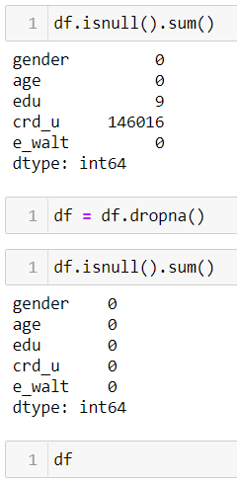
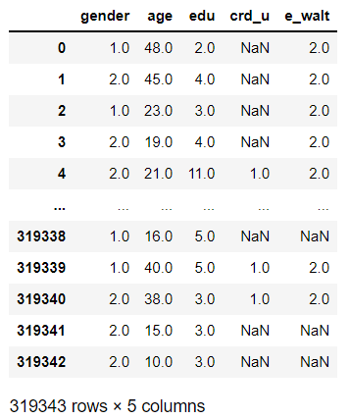
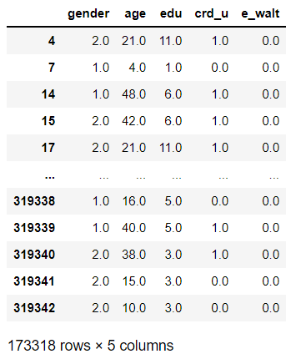

Slide 6
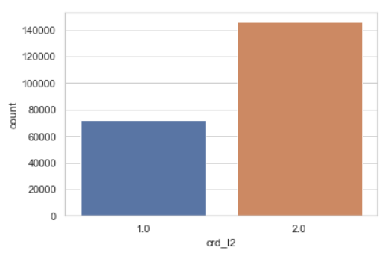
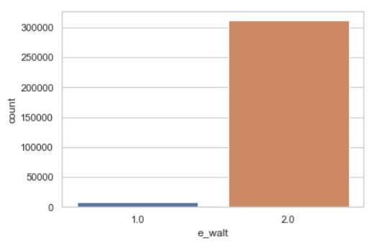
Data Analysis
The dependent features: a) Credit card users: 33.02 %
b) E-wallet users: 2.46 %

Slide 7
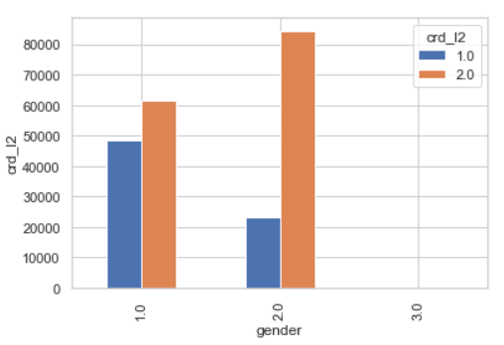
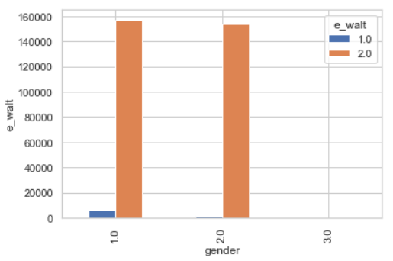
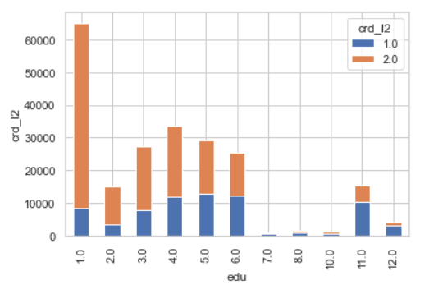
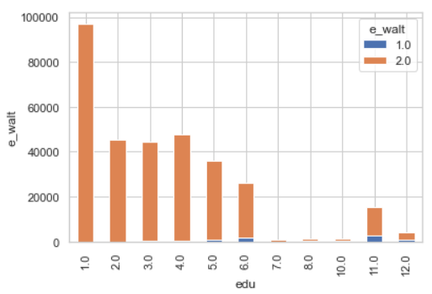

Slide 8
Algorithms
To predict the credit card and e-wallet users depending on education level, age & gender
Multiple logistic regression
Decision tree
Random forest classifier
Naïve bayes
SVM – SVC
Bagging
Boosting
Voting Classifier

Slide 9
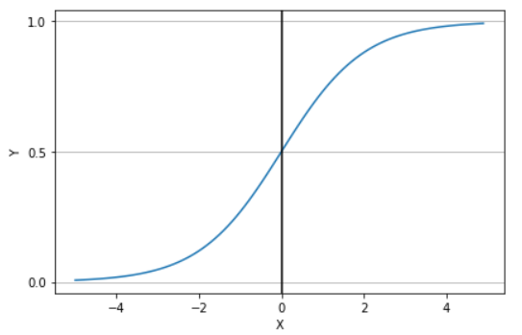
Multiple Logistic Regression
Independent features
Dependent features
Age
Gender
Education level
Credit card
E-wallet
For credit card prediction: Accuracy: 79.93%
For E-wallet prediction: Accuracy: 95.59%

Slide 10
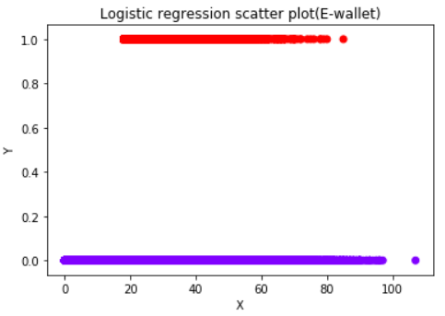
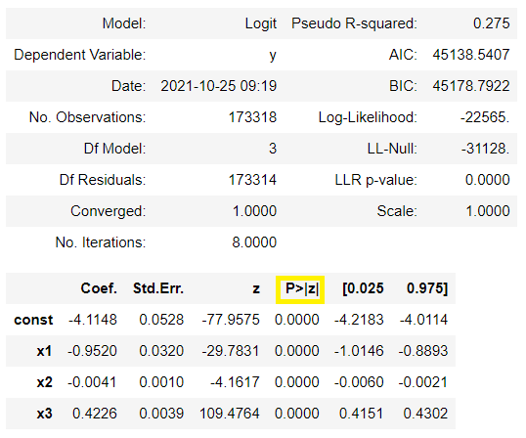
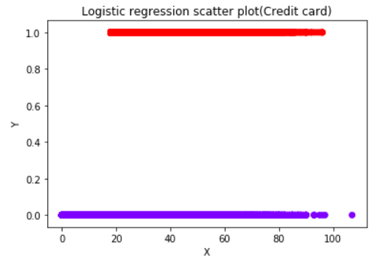

Slide 11
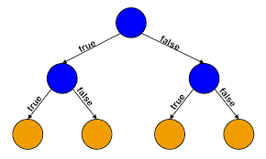
Decision Tree
For credit card prediction: Accuracy: 82.03%
For E-wallet prediction: Accuracy: 95.56%

Slide 12
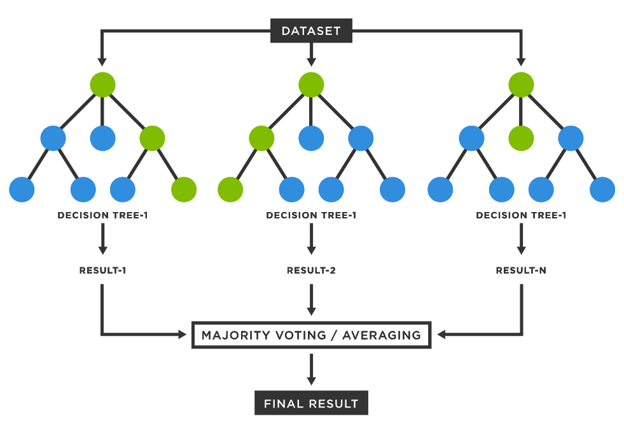
Random Forest Classifier
Number of bins = 10 – 200 (No significant change in accuracy)
For credit card prediction: Accuracy: 81.99%
For E-wallet prediction: Accuracy: 95.50%

Slide 13
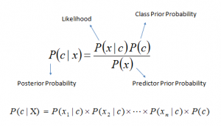
Naïve Bayes
For credit card prediction: Accuracy: 77.38%
For E-wallet prediction: Accuracy: 95.59%

Slide 14
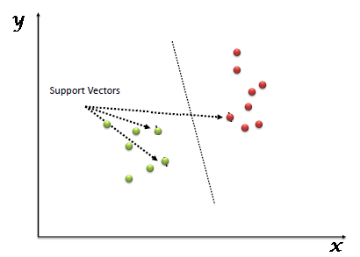
SVM- SVC
For credit card prediction: Accuracy: 79.78%
For E-wallet prediction: Accuracy: 95.59%

Slide 15
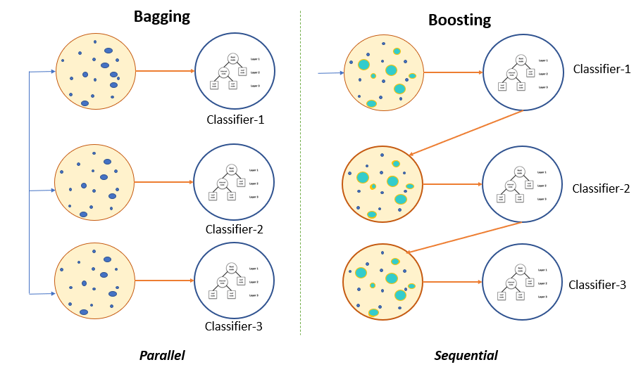
Bagging
For credit card prediction: Accuracy: 82.04%
For E-wallet prediction: Accuracy: 95.54%

Slide 16
Boosting (ABC)
For credit card prediction: Accuracy: 82.03%
For E-wallet prediction: Accuracy: 95.51%

Slide 17
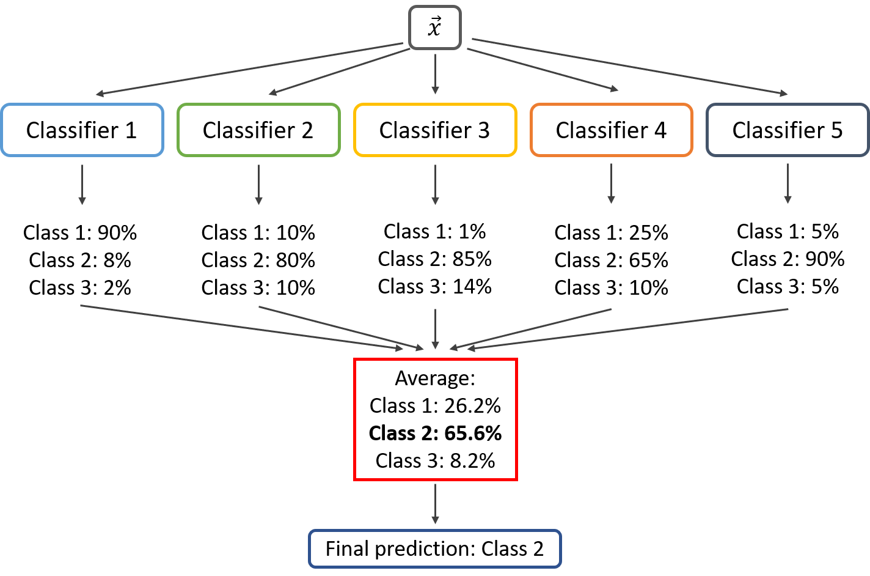
Voting classifier
(SVM, DT, Logistic)
For credit card prediction: Accuracy: 80.35%
For E-wallet prediction: Accuracy: 95.59%

Slide 18
Comparison

Slide 19
Confusion matrix analysis
Decision T | Actual +ve | Actual -ve
Predic. +ve | 46038 | 8096
Predic. -ve | 3384 | 6349
R F C | Actual +ve | Actual -ve
Predic. +ve | 45976 | 8055
Predic. -ve | 3446 | 6390
Credit
Card
Total: 31557 ✔
Total: 31586 ✔
Logistic R | Actual +ve | Actual -ve
Predic. +ve | 46929 | 10328
Predic. -ve | 2493 | 4117
Naïve Bayes | Actual +ve | Actual -ve
Predic. +ve | 49422 | 14445
Predic. -ve | 0 | 0
Total: 30211 ✘
Total: 11789 ✘

Slide 20
Decision | Actual +ve | Actual -ve
Predic. +ve | 33085 | 52
Predic. -ve | 1487 | 40
R F C | Actual +ve | Actual -ve
Predic. +ve | 33053 | 84
Predic. -ve | 1475 | 52
Total: 33125 ✔
E-wallet
Total: 33105 ✘
Logistic R | Actual +ve | Actual -ve
Predic. +ve | 33137 | 1527
Predic. -ve | 0 | 0
Naïve Bayes | Actual +ve | Actual -ve
Predic. +ve | 33137 | 1527
Predic. -ve | 0 | 0
Total: 33137 ✔
Total: 33137✔

Slide 21
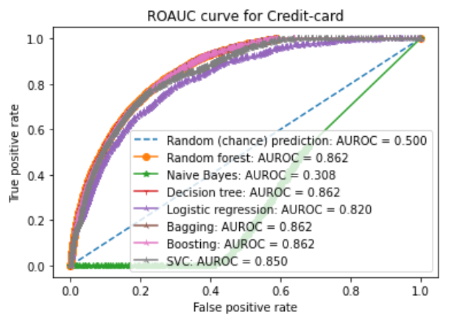
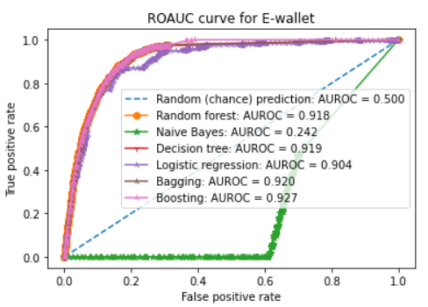
ROC AUC analysis
Credit card
E-wallet

Slide 22

Prominent feature
Best affecting parameters :
Education: 18.86%|55.25%
Age: 78.68%|39.46%
Gender: 2.45%|5.47%
Algorithms:
Decision tree ✔
Random Forest ✔
Multivariate logistic regression ✔
Naïve bayes ✘

Slide 23
Post-midway plans
Building and testing different classifier models for household data
Analysing features such as monthly household expenditure and land ownership as indicator for credit worthiness.
Working on previous loan transactions and amount lent as measure of loan prediction.
Using indicators such as social group, household type and religion to establish relationship between debt and social status.
Try to merge household data with individual data to find more collective results.

Slide 24
References
Joseph Adwere-Boamah – “Multiple logistic regression analysis of cigarette use among high school students”, Journal of Case Studies in Education
Leo Breiman – “Random Forests”, Statistics Department University of California Berkeley, CA 94720 (January 2001)
I. Rish – “An empirical study of the naive Bayes classifier”, T.J. Watson Research Center

Slide 25


